Slide 1
CYK Algorithm for Parsing
29 July 2020
https://github.com/CRLala/CYK_Algorithm_for_Parsing
Chiraag Lala

Slide 2
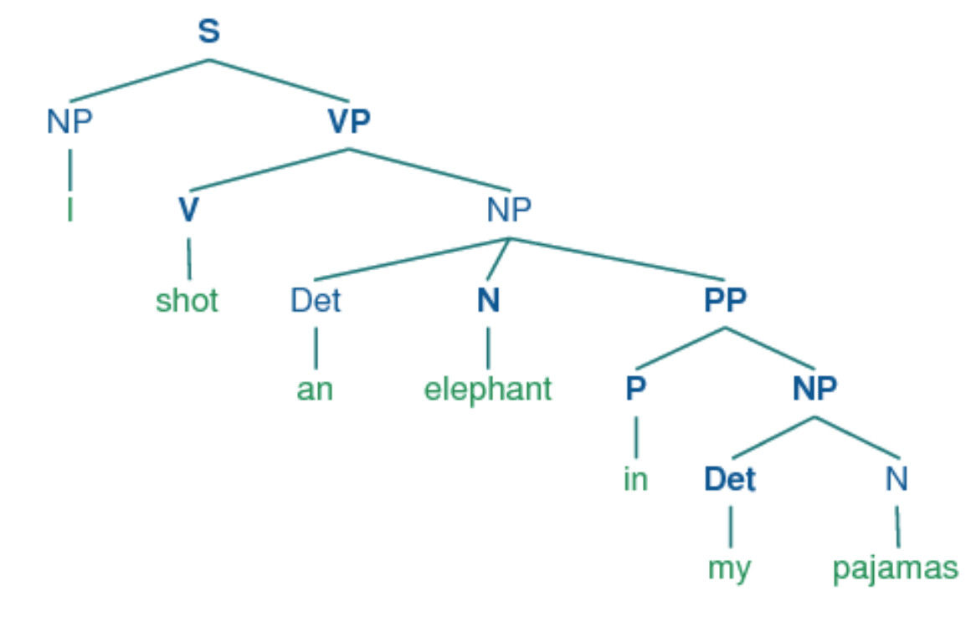
Constituency Parsing
Given a sequence of tokens (a sentence), generate its syntactic structure (a parse tree) which conforms to a Grammar.

Slide 3
Applications of Parsing
Grammar checking
As representation / features for downstream tasks:
Question Answering
Information Extraction
Named Entity Recognition
Machine Translation
…

Slide 4
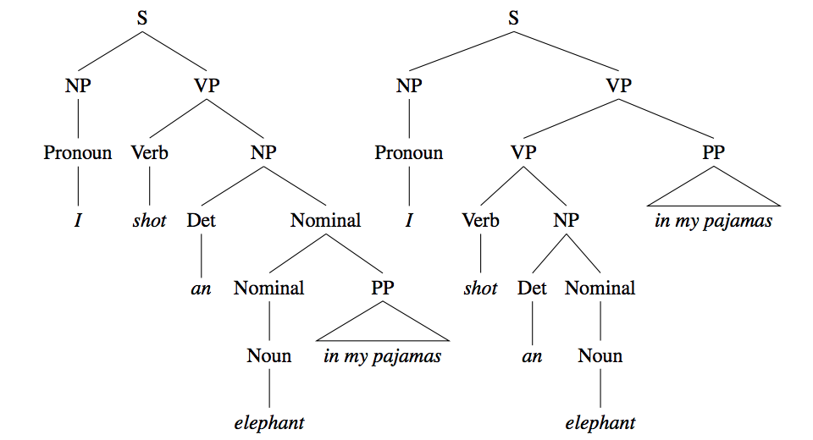
Challenges
It is hard. The simple brute-force method has exponential time complexity.
Structural Ambiguity

Slide 5
Addressing the Challenges
Cocke-Younger-Kasami (CYK) Algorithm
Probabilistic Context-Free Grammar (PCFG)

Slide 6
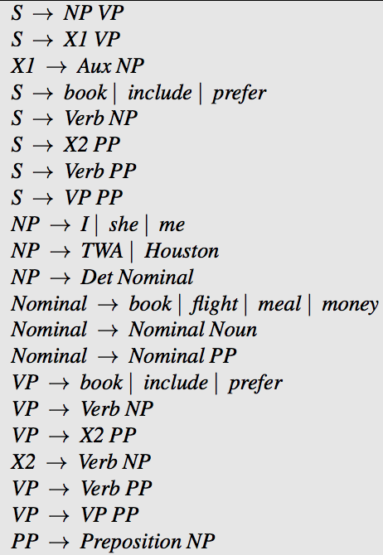
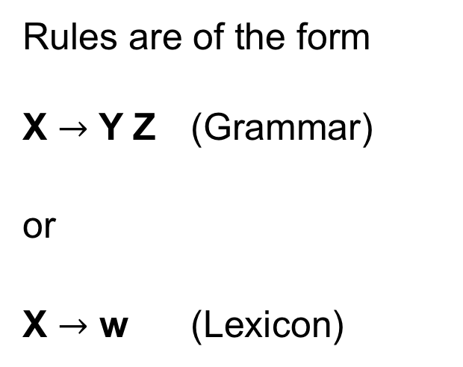
Context-Free Grammar (CFG) in Chomsky Normal Form (CNF)
Rules are of the form X $→$ Y Z (Grammar)
or
X $→$ w (Lexicon)

Slide 7
Cocke-Younger-Kasami Algorithm
Dynamic programming algorithm with polynomial time complexity.
Input: sequence of words (sentence) and a CFG in CNF
Returns: n x n matrix of all possible parse trees
n is length of the sentence
Kasami, T. (1965). An efficient recognition and syntax analysis algorithm for context-free languages. Tech. rep. AFCRL-65-758, Air Force Cambridge Research Laboratory, Bedford, MA.
Younger, D. H. (1967). Recognition and parsing of contextfree languages in time n 3 . Information and Control, 10, 189–208.

Slide 8
CYK Algorithm: Pseudocode
function CKY(sentence, grammar) returns table
for j from 1 to length(sentence) do
for all {A | A → sentence[j] ∈ grammar}
table[j, j] ← table[j, j] ∪ A
for step from 1 to length(sentence)-1 do
for row from 1 to length(sentence)-step do
col ← row + step
for k from 0 to step-1 do
for all {A | A → BC ∈ grammar
and B ∈ table[row, row+k]
and C ∈ table[row+k+1, col]}
table[row][col] ← table[row, col] ∪ A

Slide 9
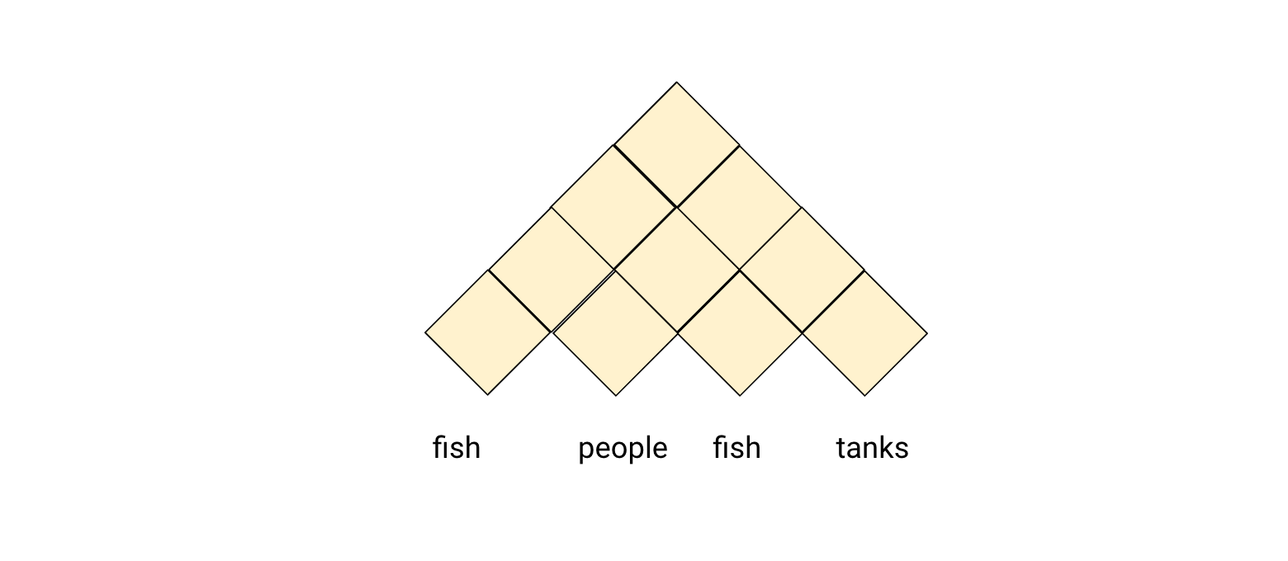
CYK Algorithm: Intuition

Slide 10
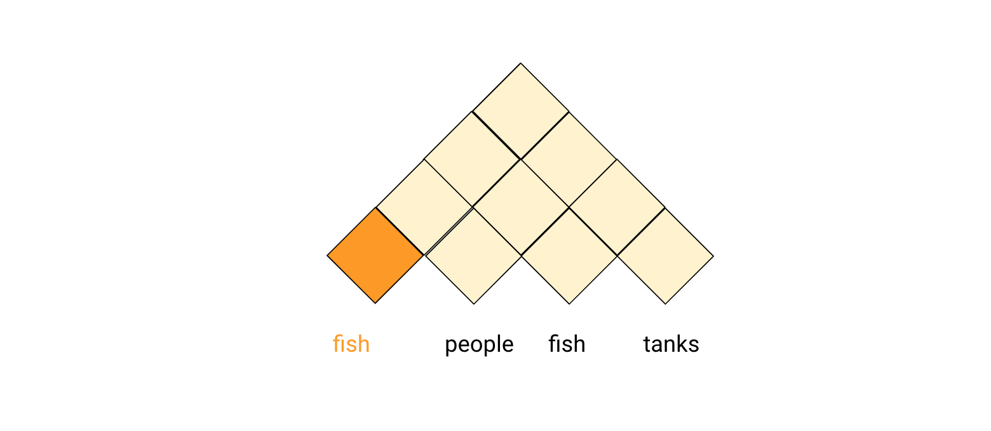
CYK Algorithm: Intuition

Slide 11
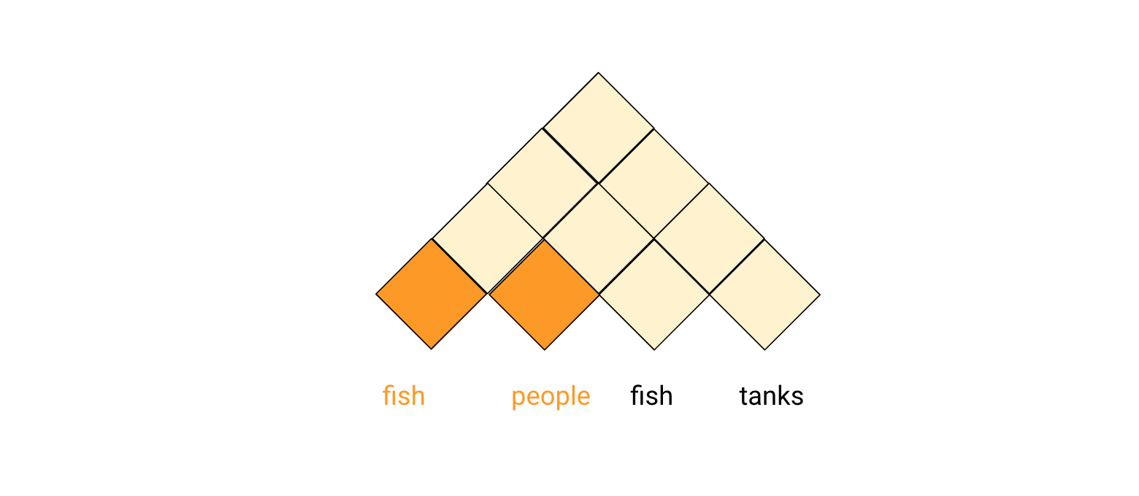
CYK Algorithm: Intuition

Slide 12
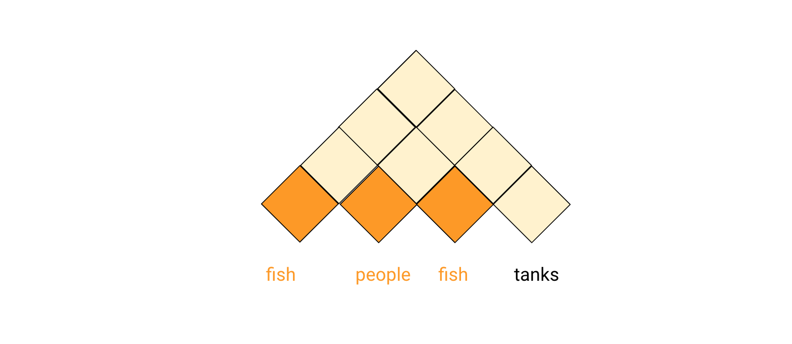
CYK Algorithm: Intuition

Slide 13
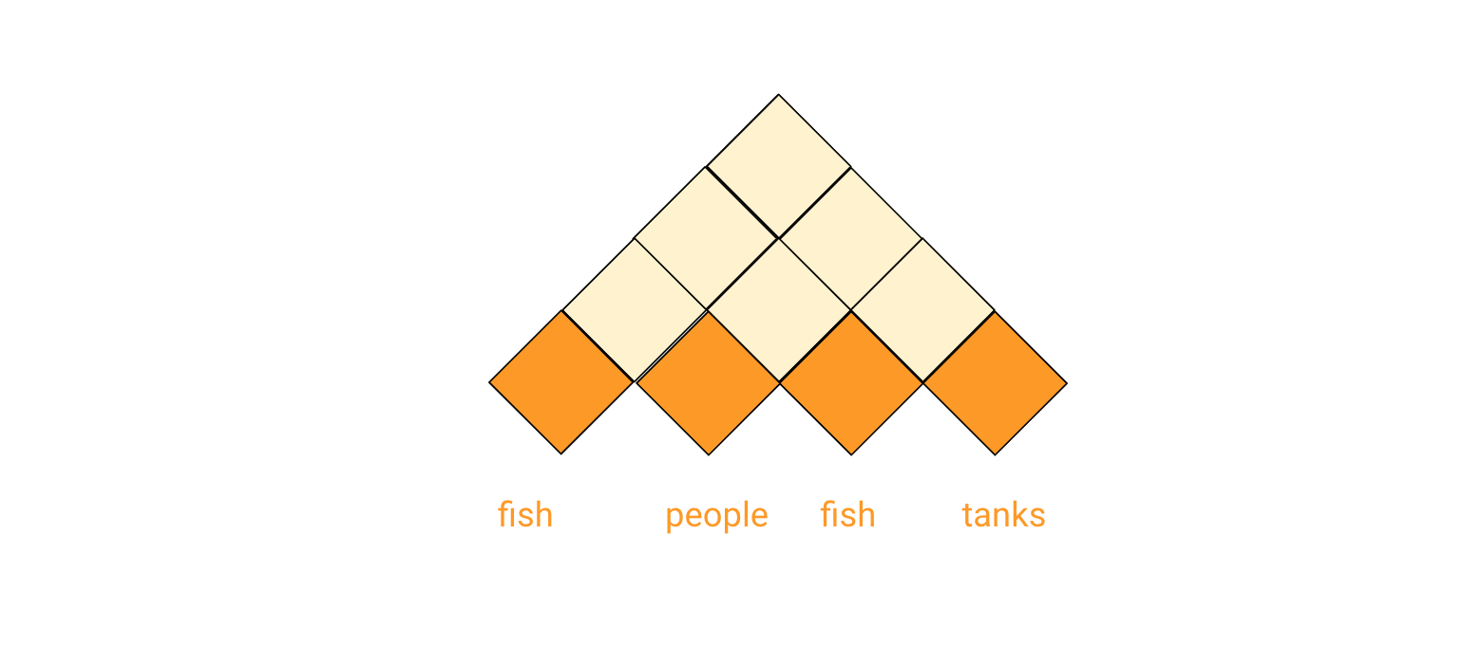
CYK Algorithm: Intuition

Slide 14
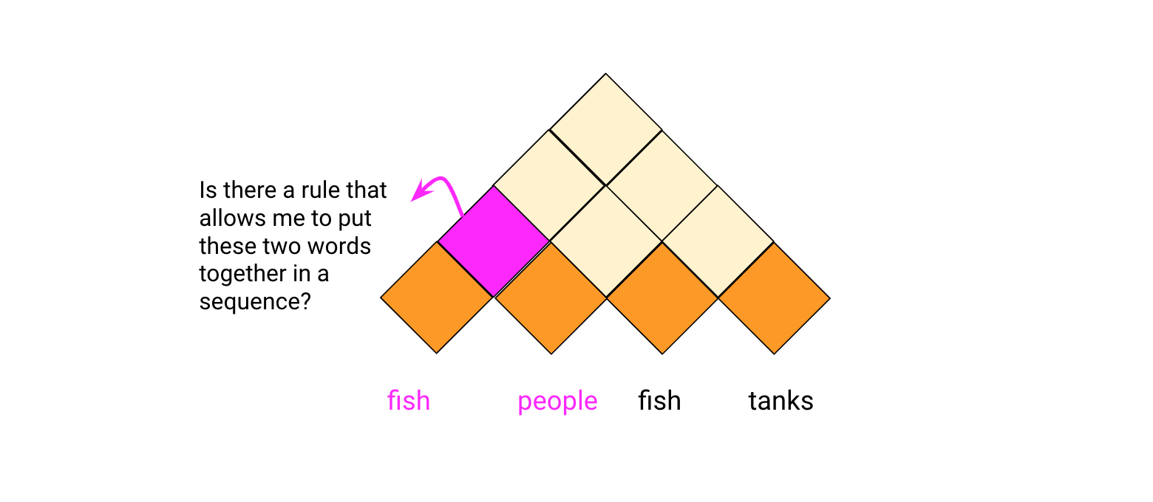
CYK Algorithm: Intuition

Slide 15
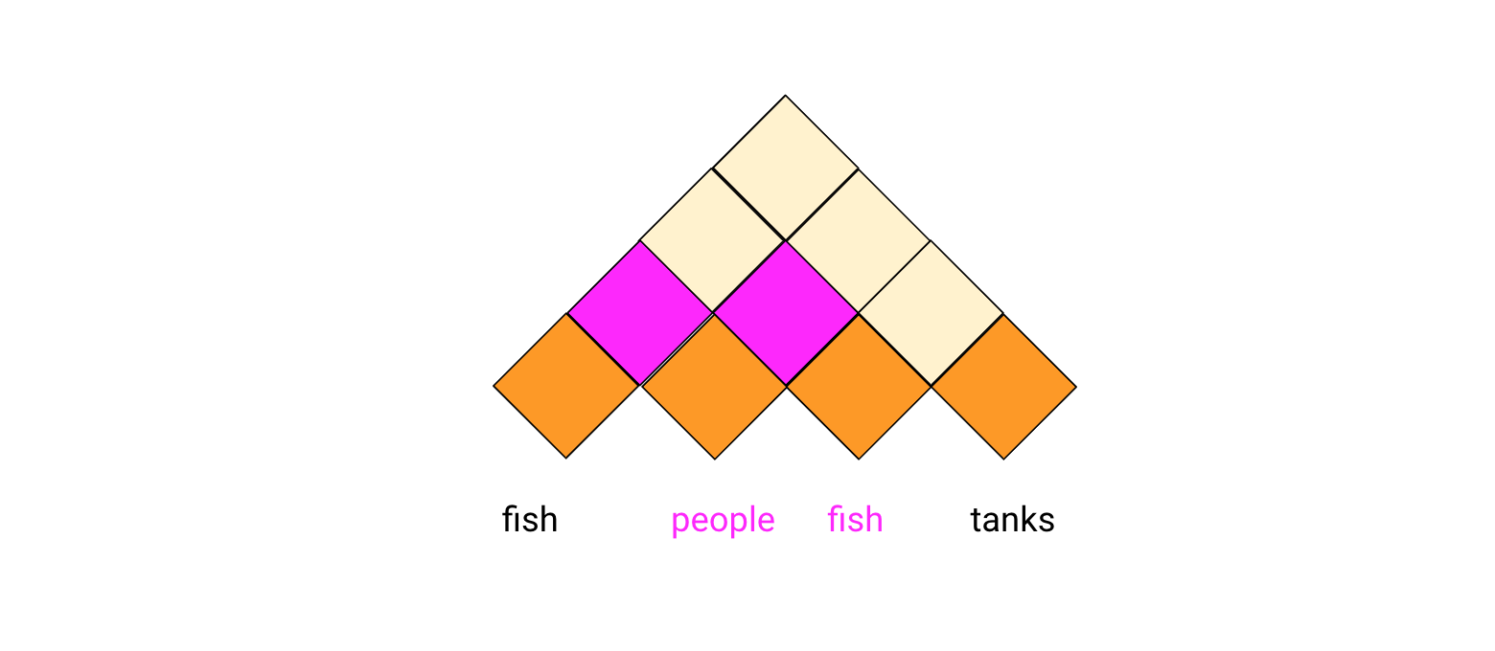
CYK Algorithm: Intuition

Slide 16
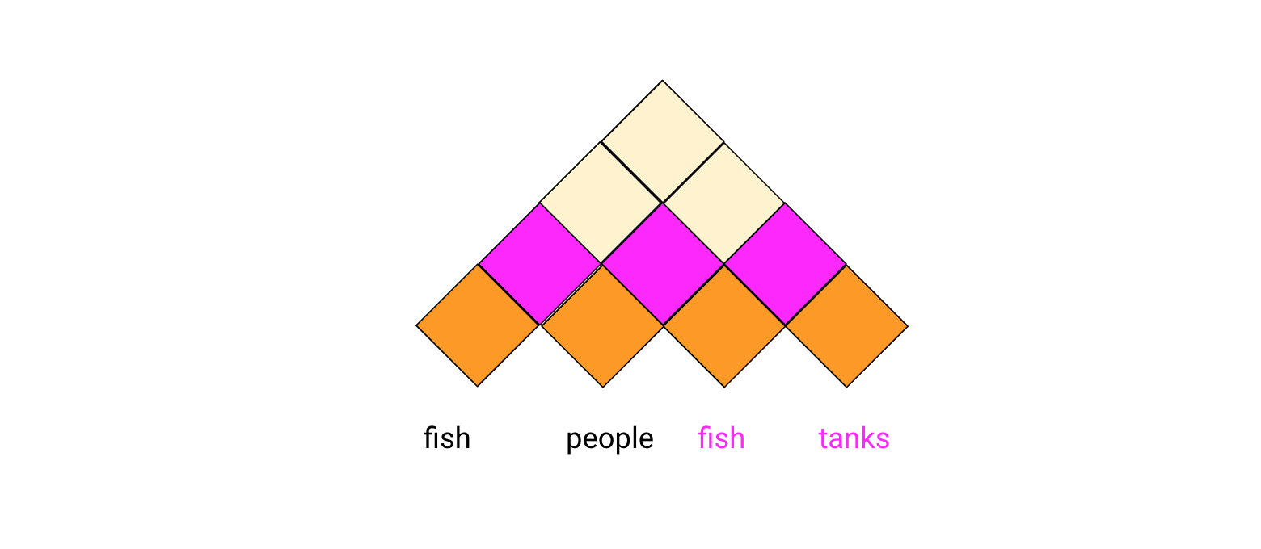
CYK Algorithm: Intuition

Slide 17
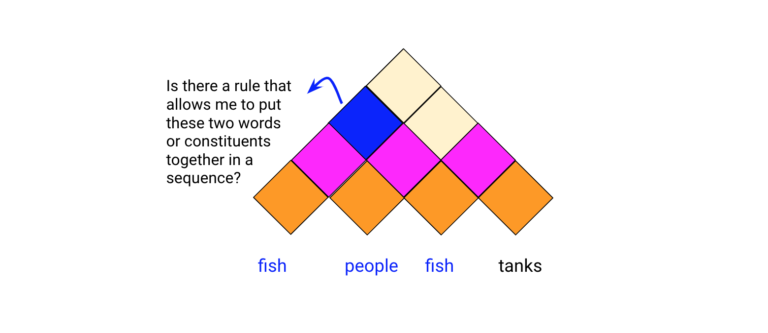
CYK Algorithm: Intuition

Slide 18
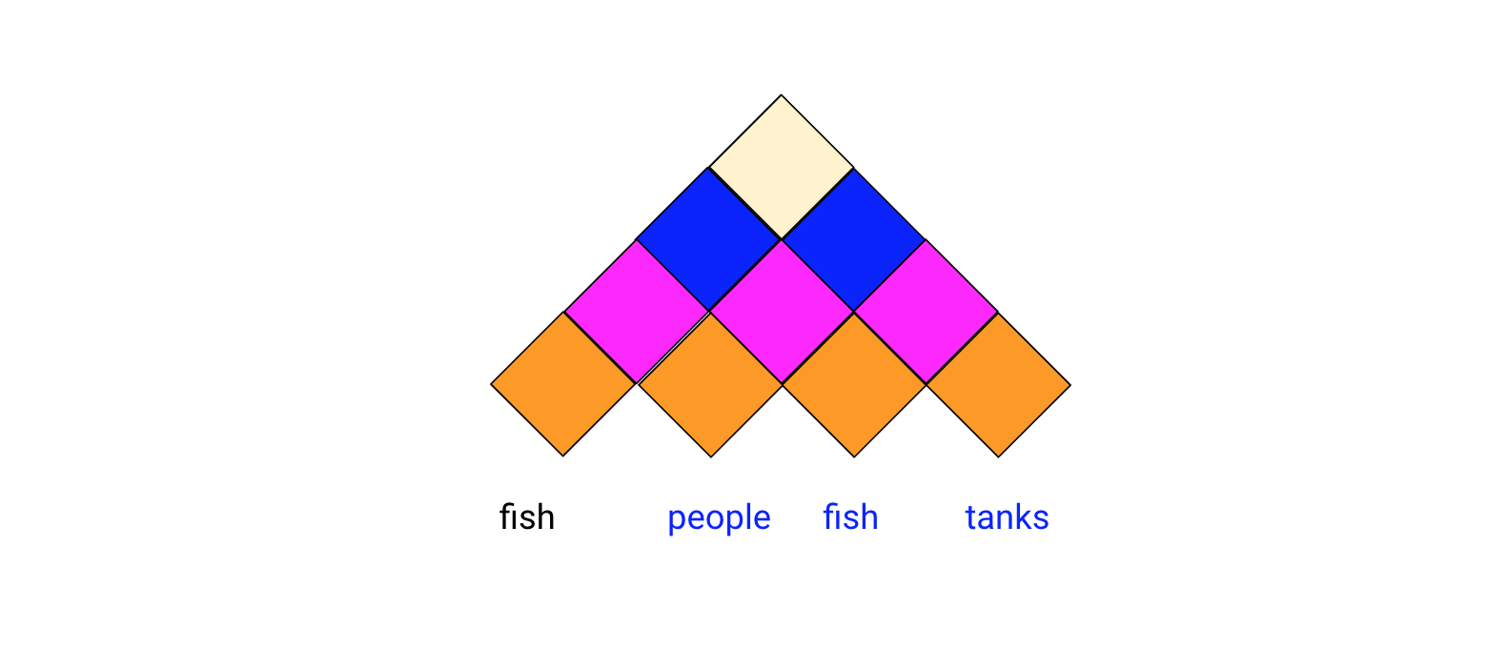
CYK Algorithm: Intuition

Slide 19
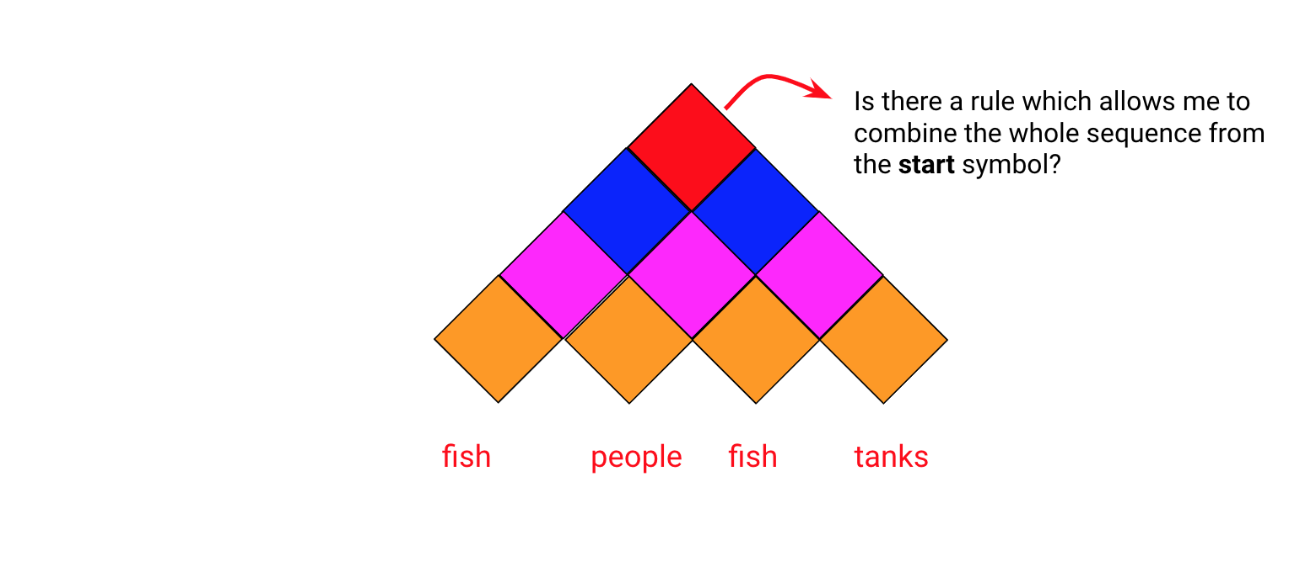
CYK Algorithm: Intuition

Slide 20
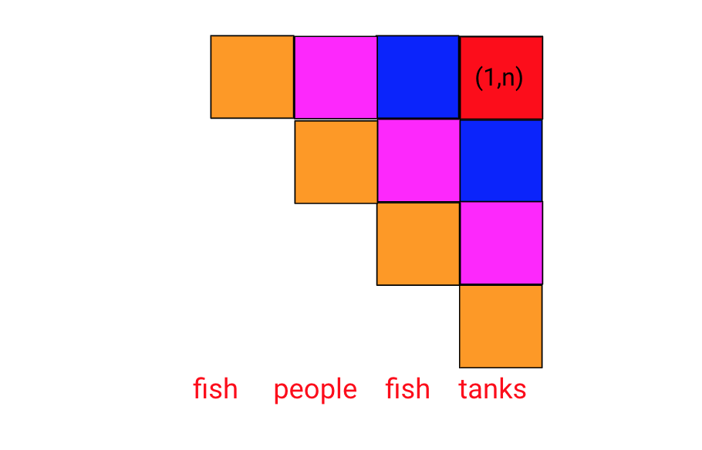
CYK Algorithm: Intuition

Slide 21
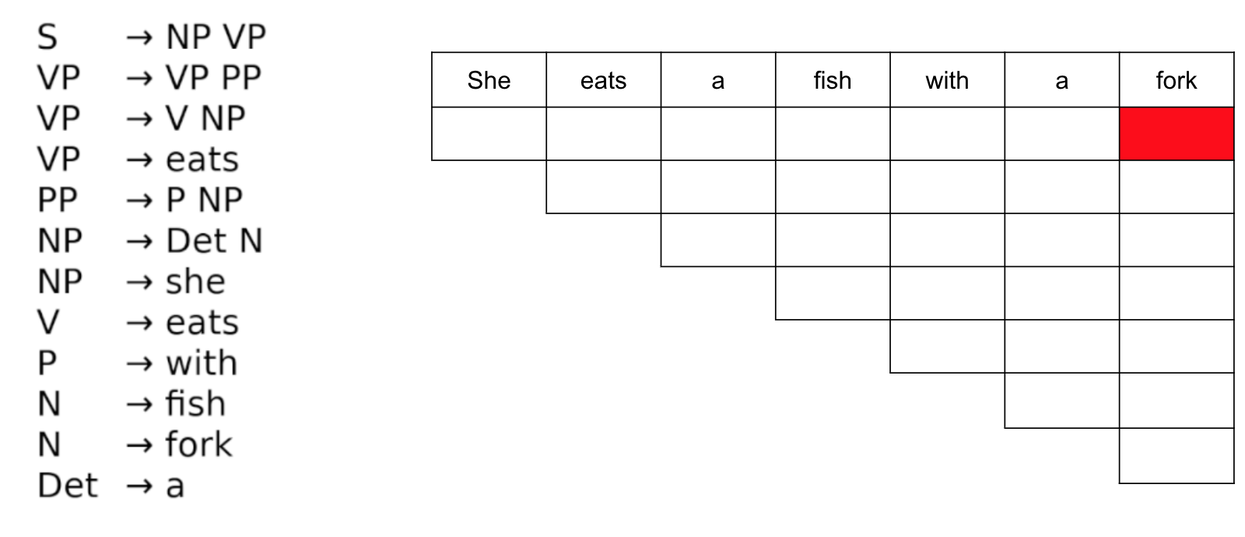
CYK Algorithm: Example

Slide 22
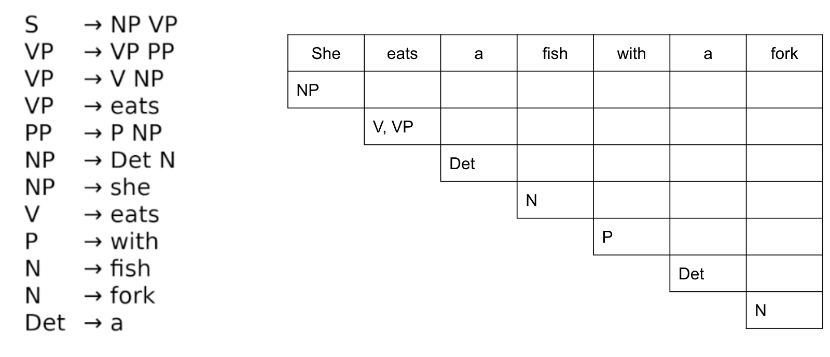
CYK Algorithm: Example

Slide 23
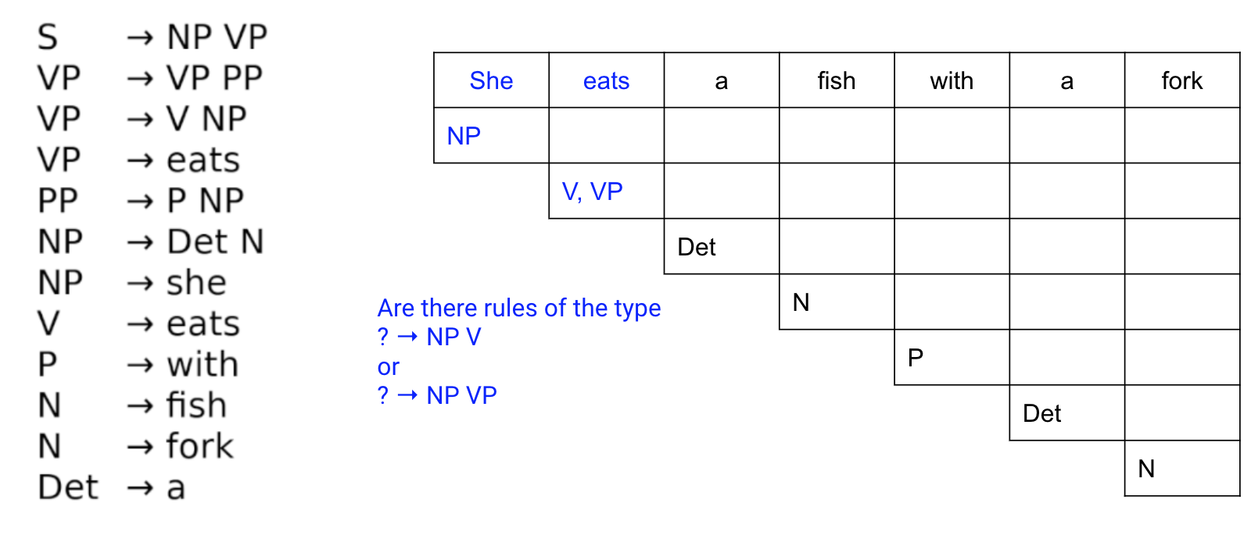
CYK Algorithm: Example

Slide 24
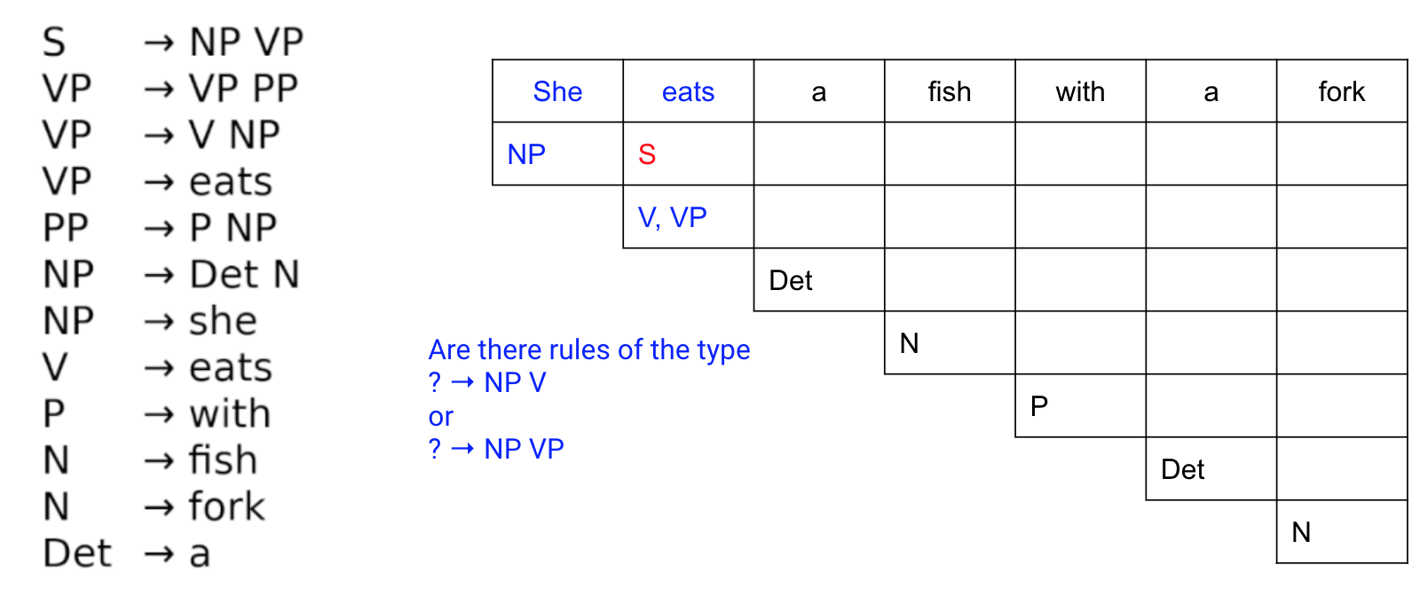
CYK Algorithm: Example

Slide 25

CYK Algorithm: Example

Slide 26

CYK Algorithm: Example

Slide 27
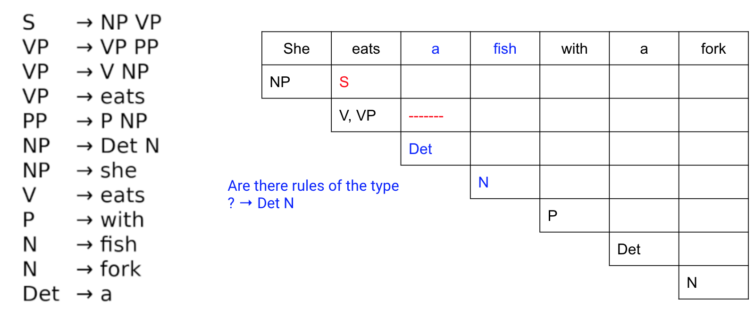
CYK Algorithm: Example

Slide 28
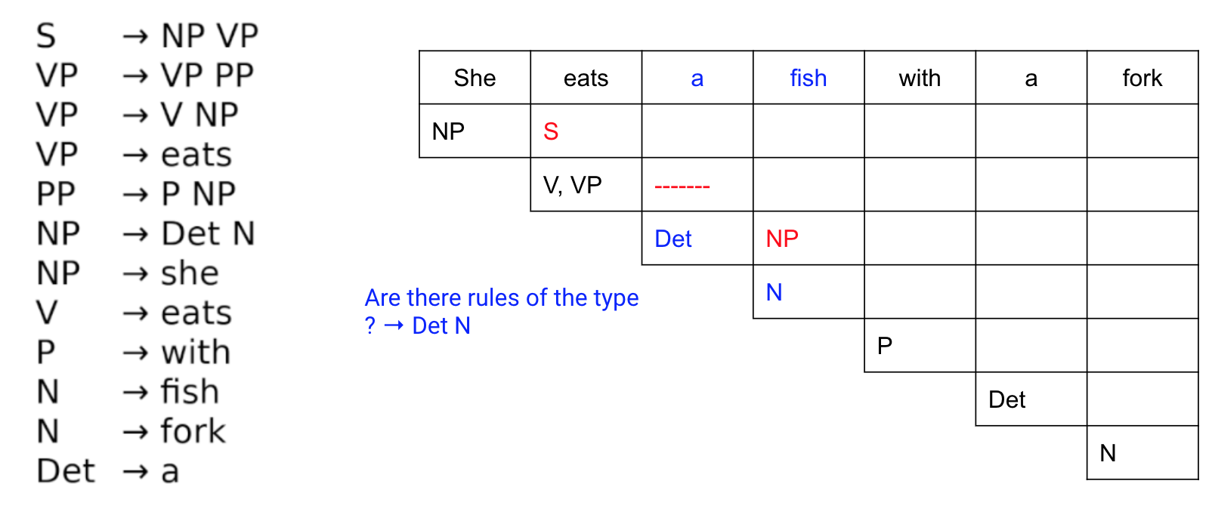
CYK Algorithm: Example

Slide 29
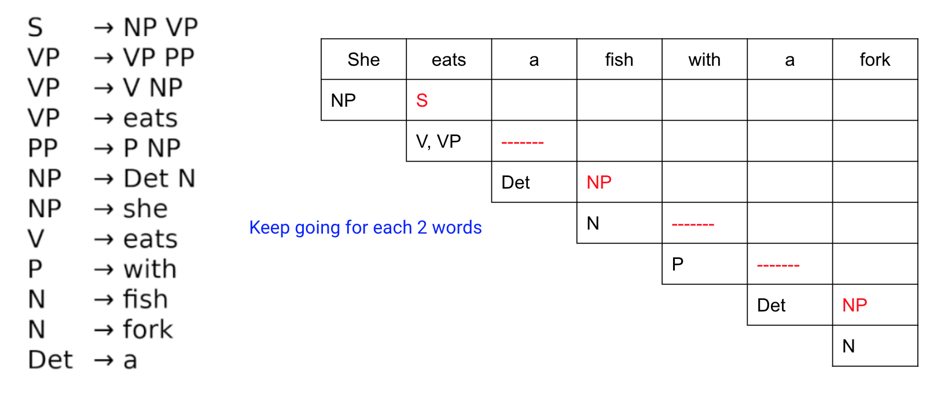
CYK Algorithm: Example

Slide 30
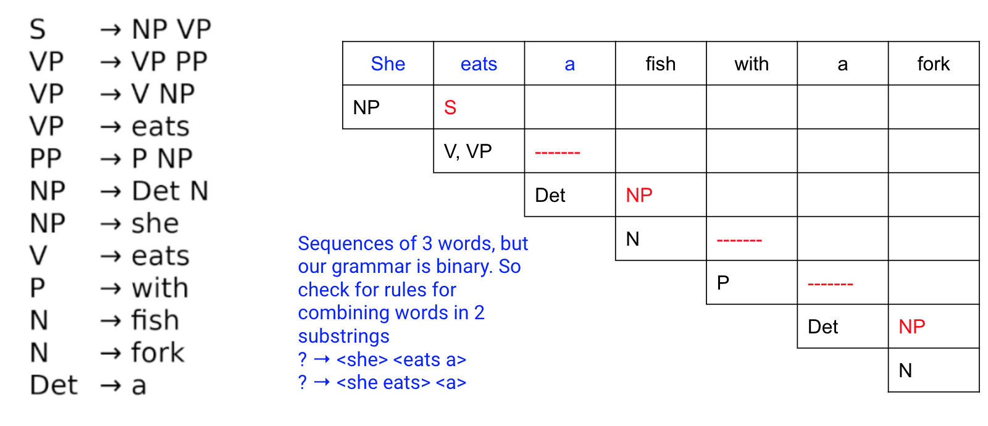
CYK Algorithm: Example

Slide 31
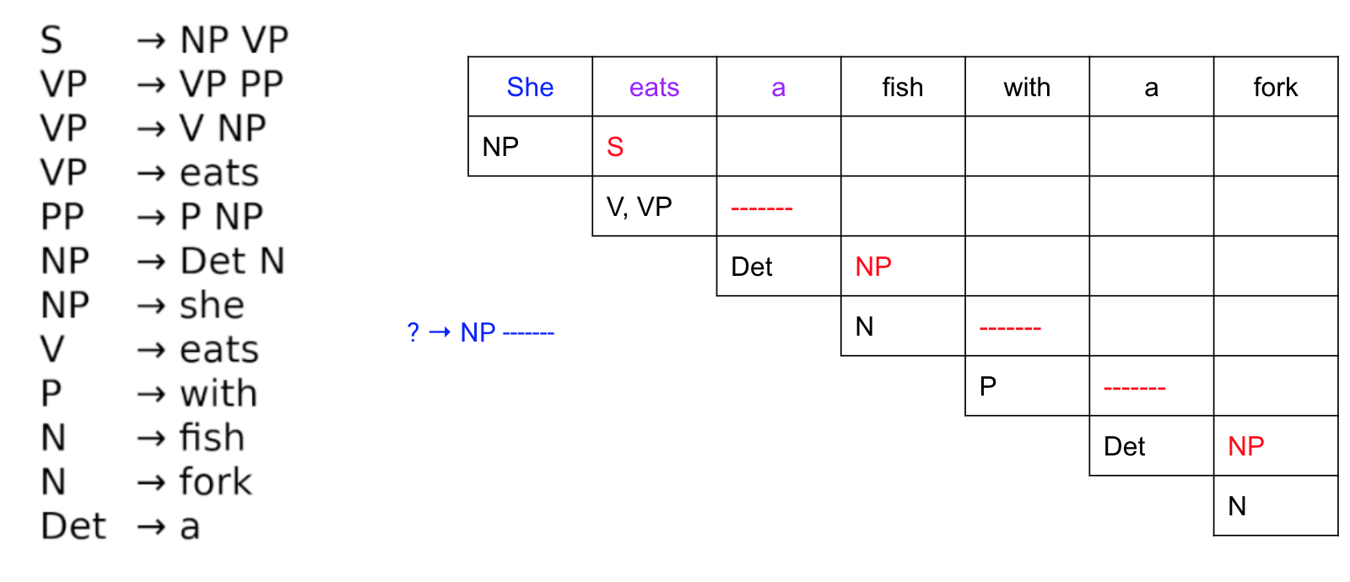
CYK Algorithm: Example

Slide 32

CYK Algorithm: Example

Slide 33
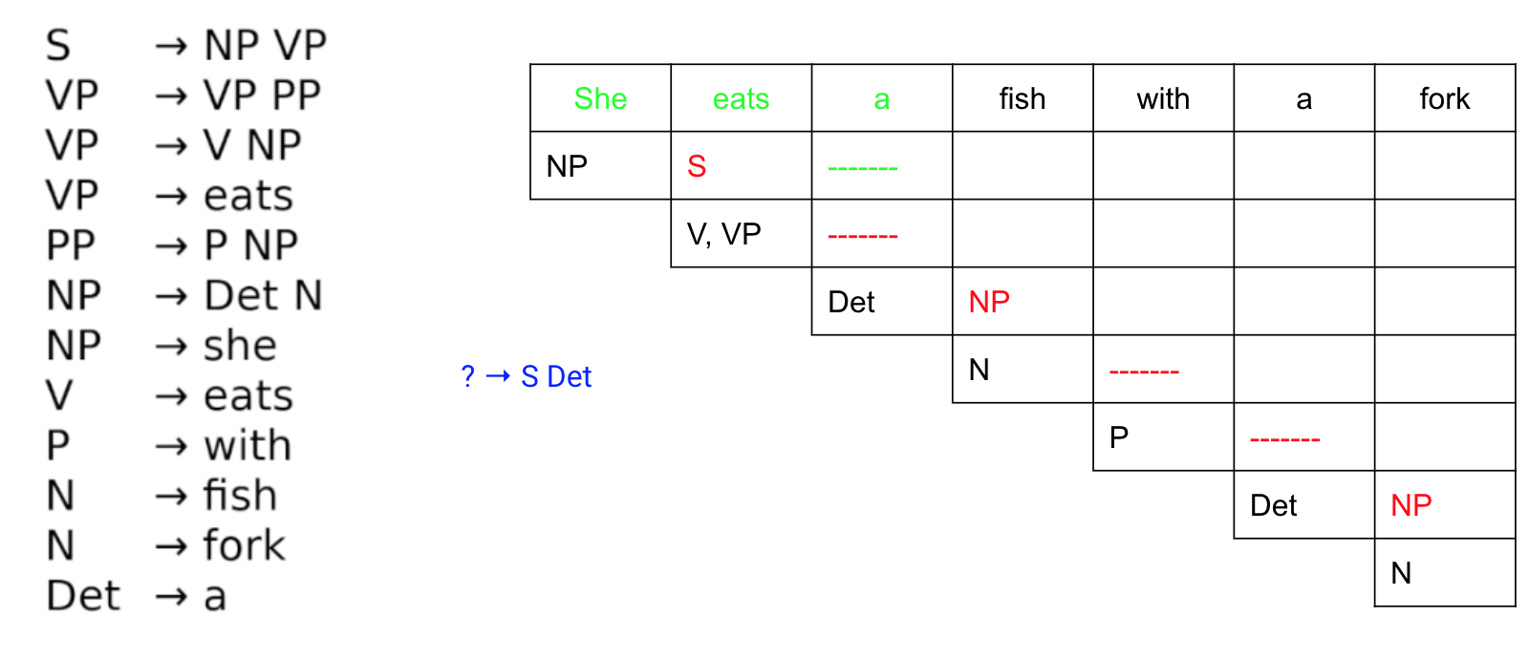
CYK Algorithm: Example

Slide 34
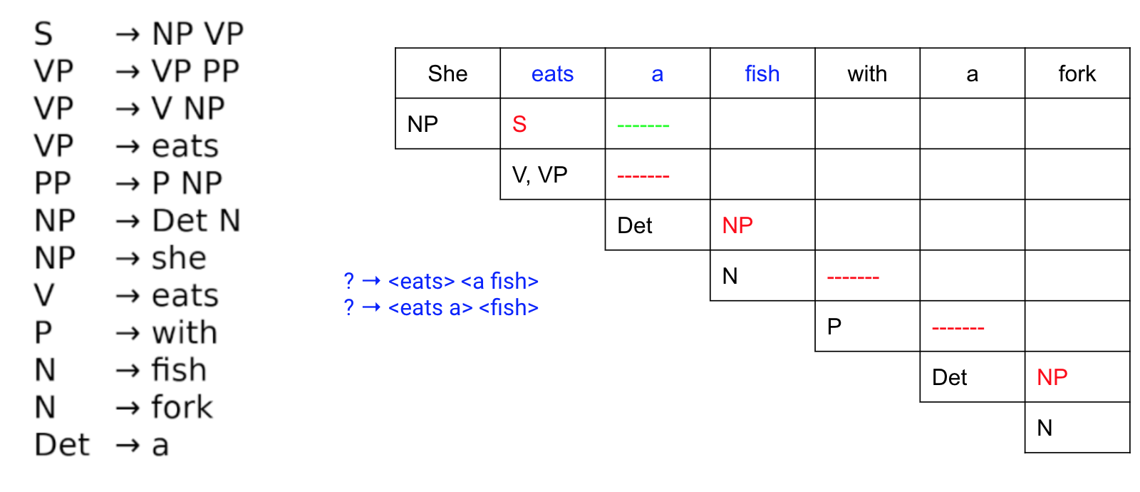
CYK Algorithm: Example

Slide 35
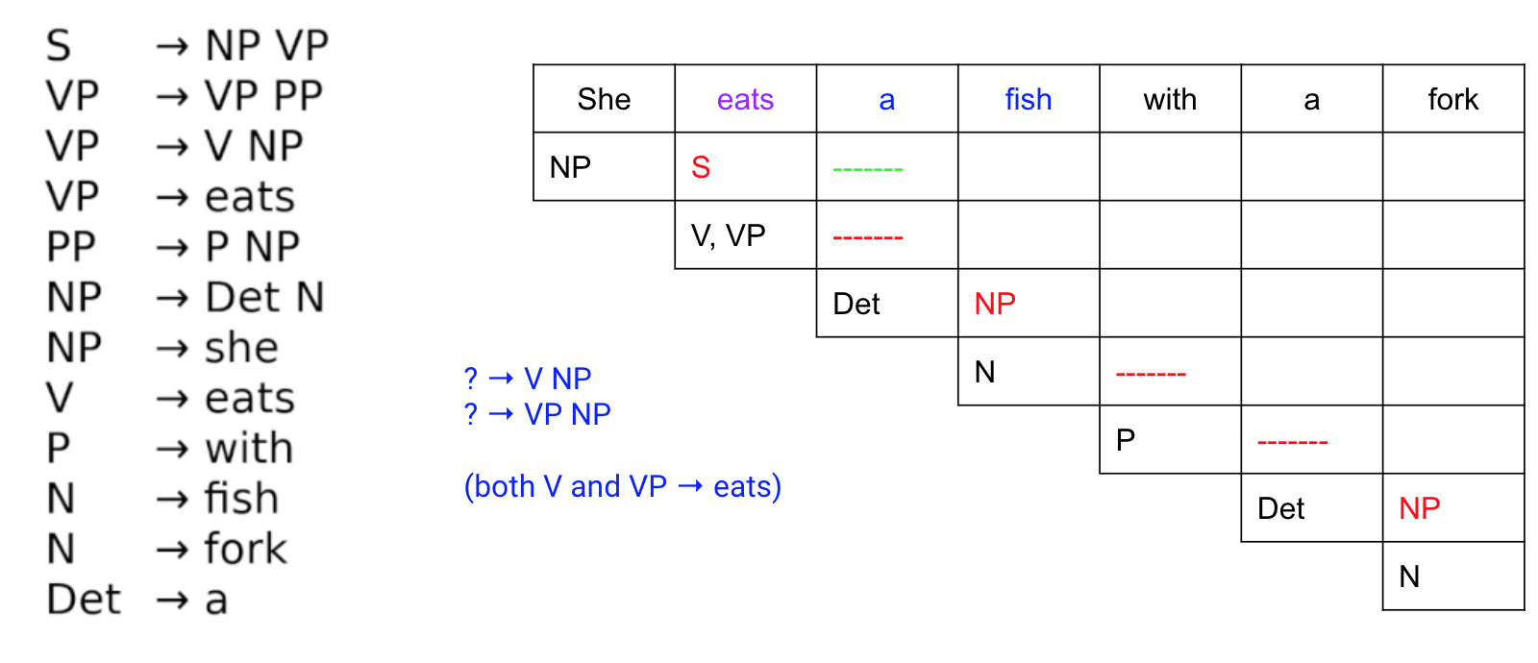
CYK Algorithm: Example

Slide 36
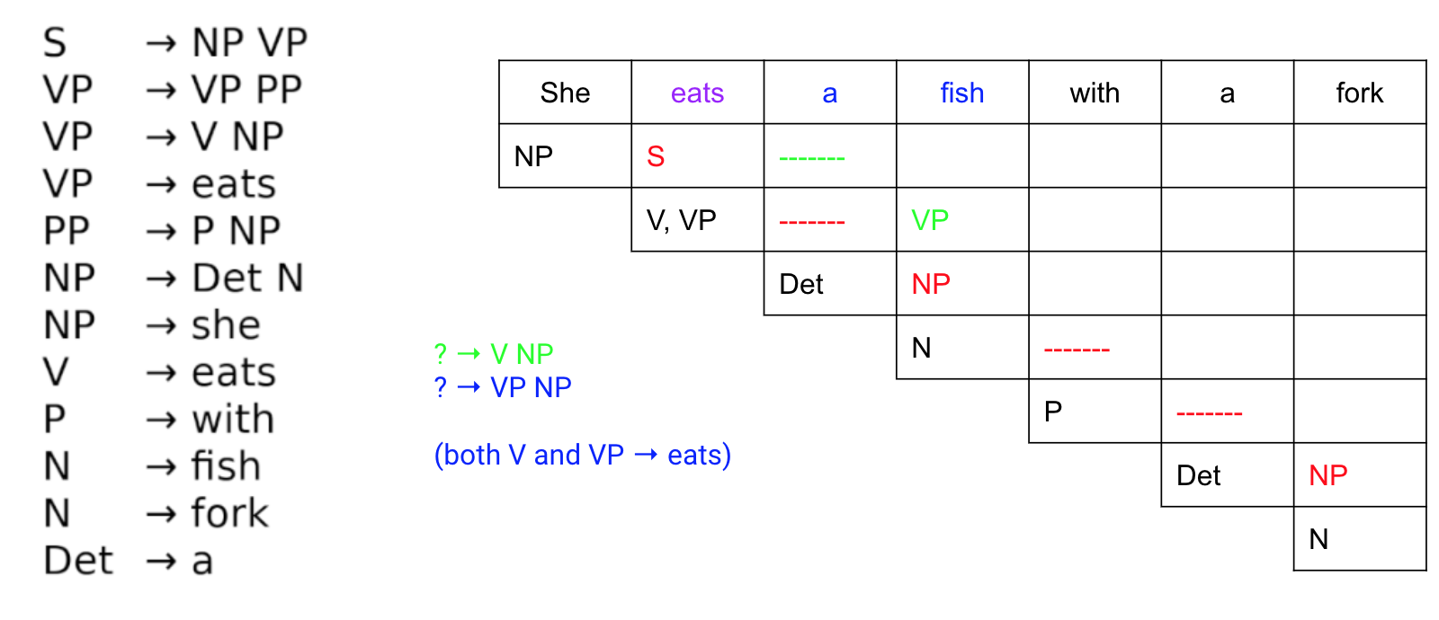
CYK Algorithm: Example

Slide 37
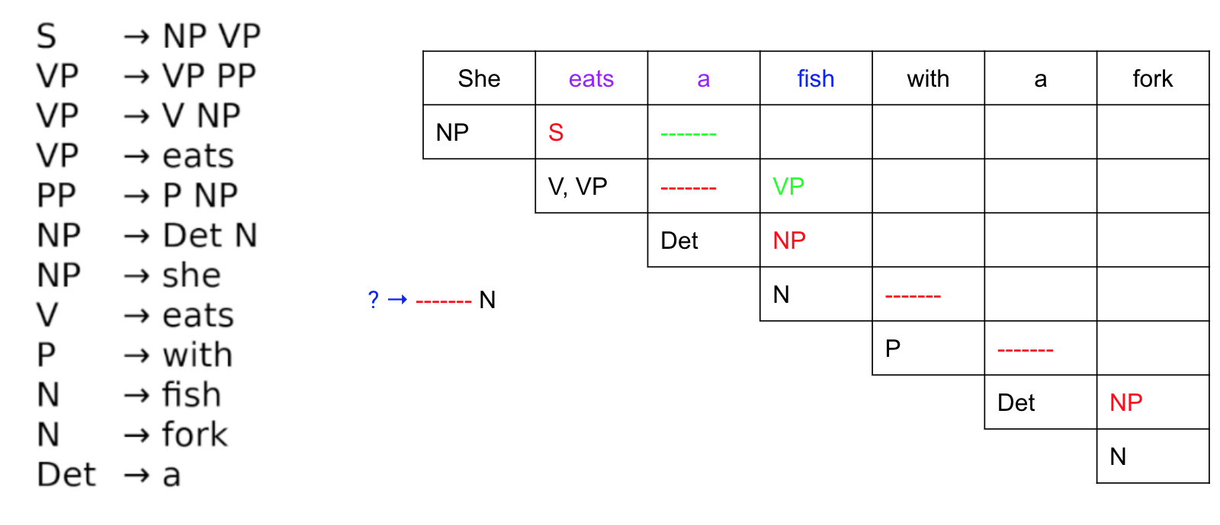
CYK Algorithm: Example

Slide 38
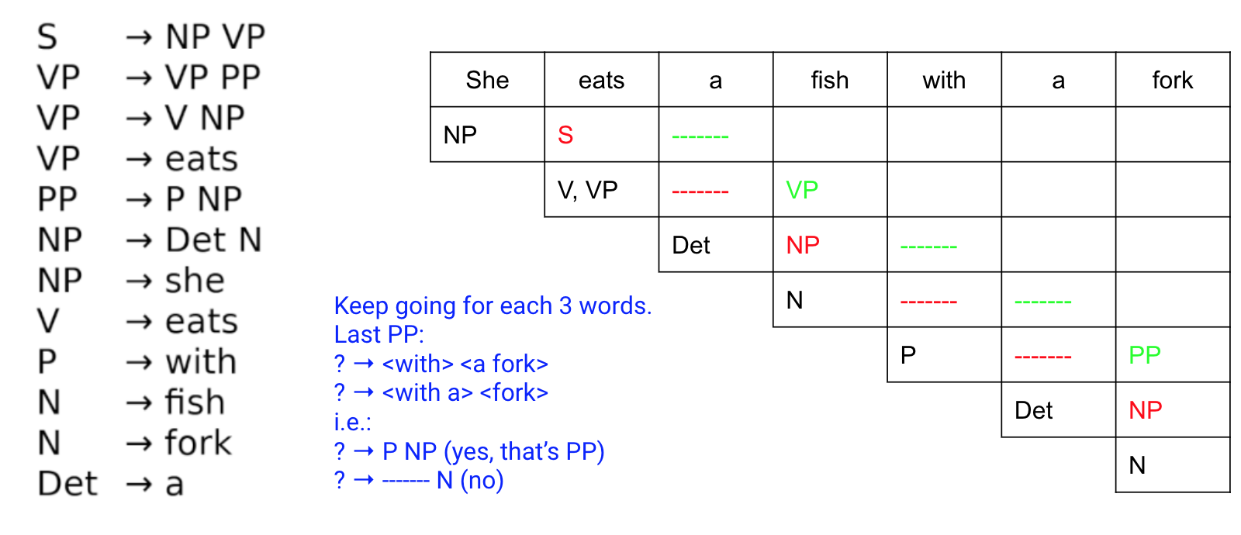
CYK Algorithm: Example

Slide 39
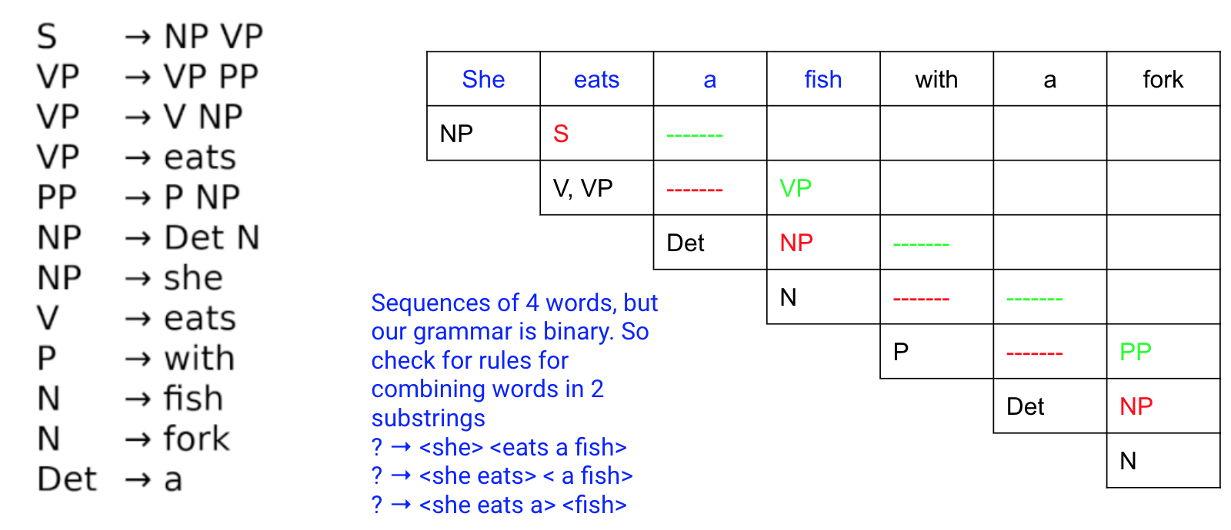
CYK Algorithm: Example

Slide 40
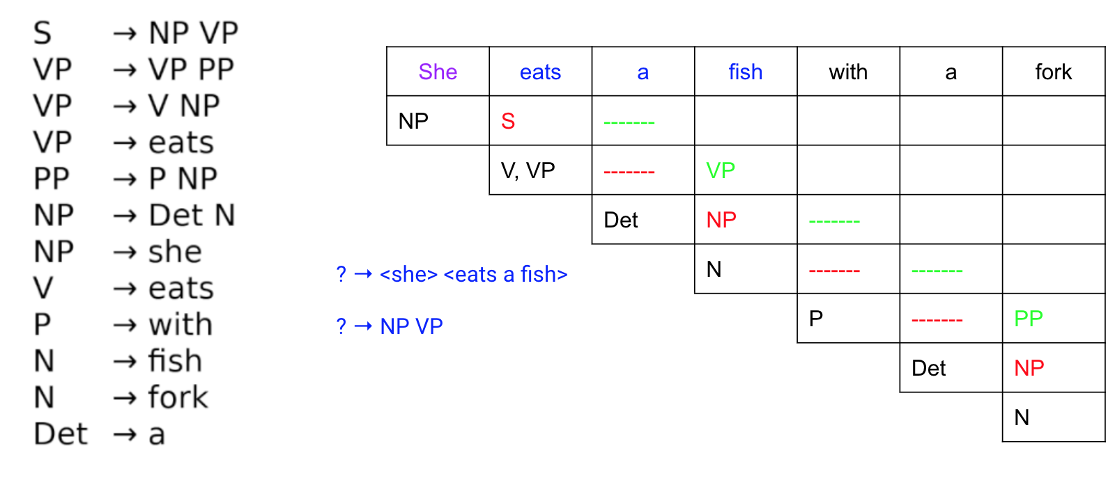
CYK Algorithm: Example

Slide 41
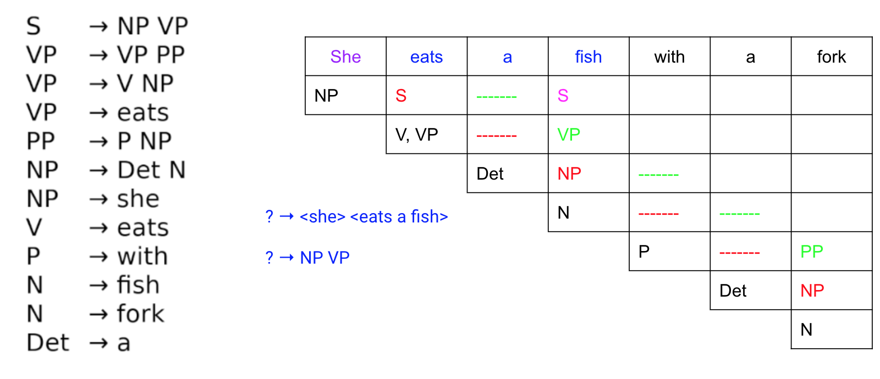
CYK Algorithm: Example

Slide 42
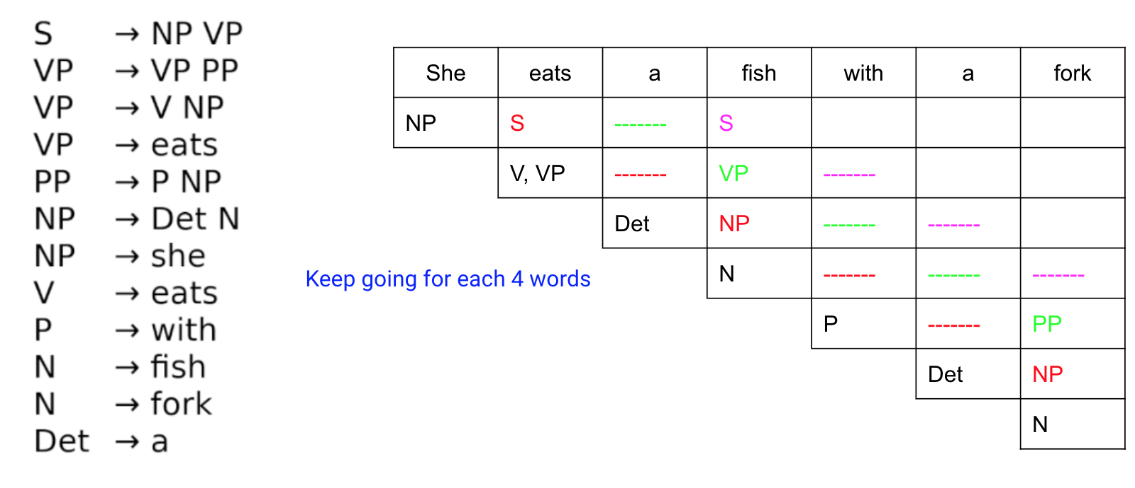
CYK Algorithm: Example

Slide 43

CYK Algorithm: Example

Slide 44
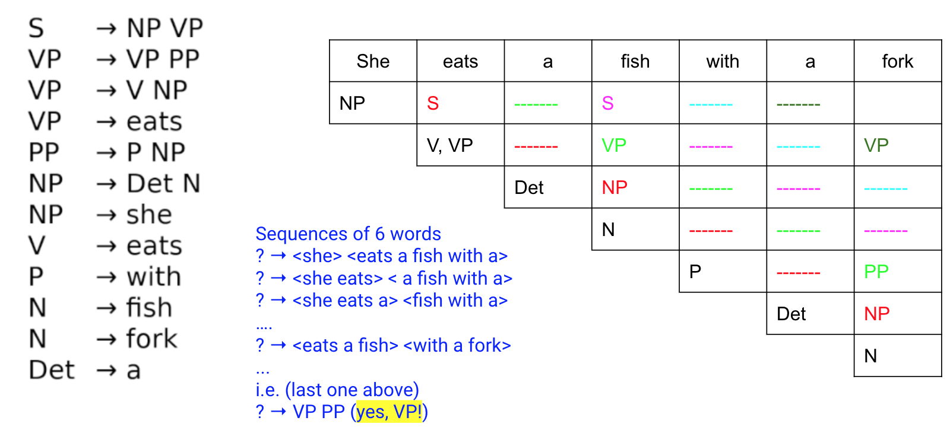
CYK Algorithm: Example

Slide 45
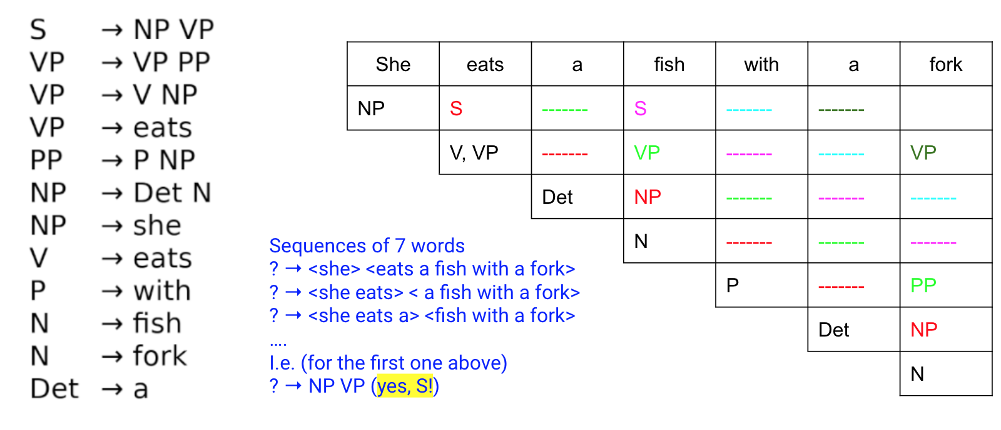
CYK Algorithm: Example

Slide 46
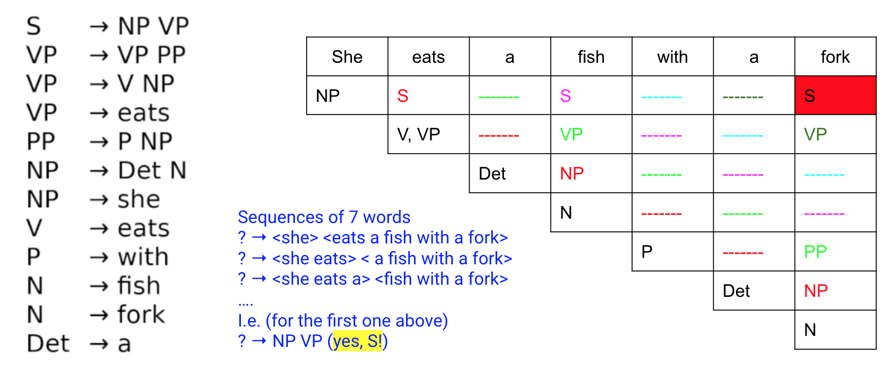
CYK Algorithm: Example

Slide 47
CYK Algorithm: What is the time complexity?
Pause the video and calculate

Slide 48
CYK Algorithm: How to retrieve parse trees?
Backpointer!
When filling up a cell with a particular non-terminal, also store the cells and the symbols used.

Slide 49
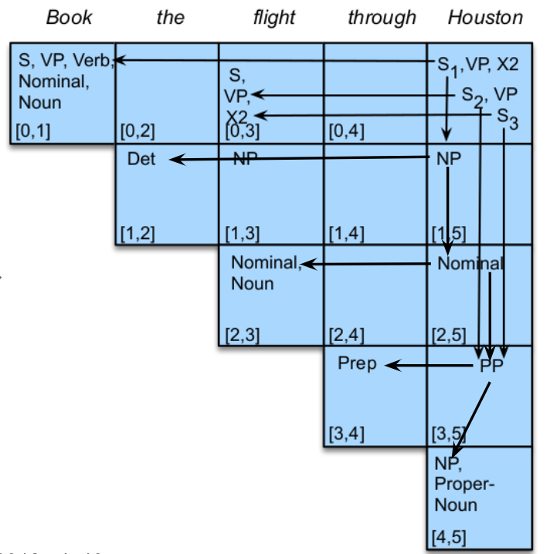
CYK Algorithm: How to retrieve parse trees?
From Jurafsky, D and Martin, J, “Speech and Language Processing,” 2018, ch 13

Slide 50
How to retrieve the most probable parse tree?
Probabilistic Context-Free Grammar (PCFG) in Chomsky Normal Form

Slide 51
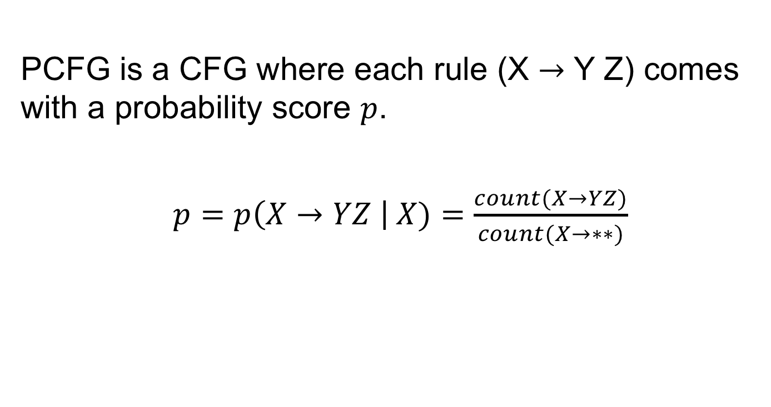
Probabilistic Context-Free Grammar
PCFG is a CFG where each rule (X $→$ Y Z) comes with a probability score $p$.
$p=p\left(X→YZ \right| X)=\frac{count(X→YZ)}{count(X→∗∗)}$

Slide 52
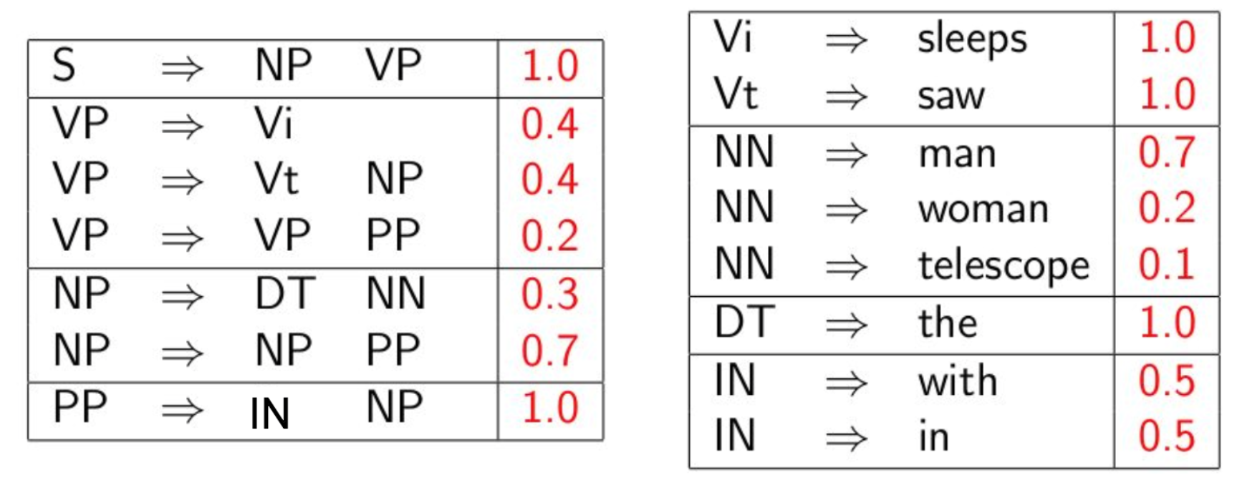
PCFG Example

Slide 53
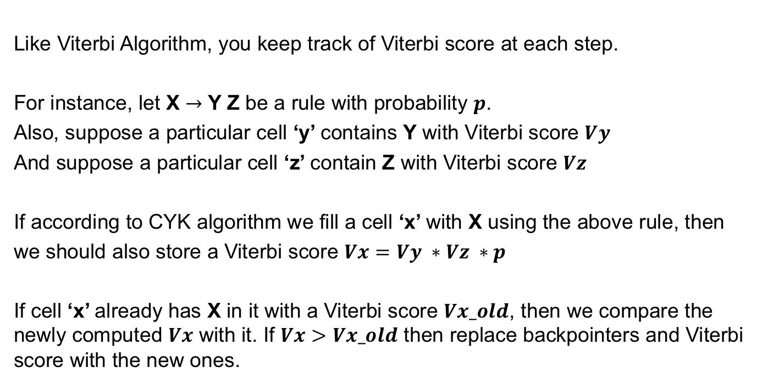
CYK Algorithm using PCFG
Like Viterbi Algorithm, you keep track of Viterbi score at each step.
For instance, let X $→$ Y Z be a rule with probability $p$.
Also, suppose a particular cell ‘y’ contains Y with Viterbi score $Vy$
And suppose a particular cell ‘z’ contain Z with Viterbi score $Vz$
If according to CYK algorithm we fill a cell ‘x’ with X using the above rule, then
we should also store a Viterbi score $Vx=Vy ∗Vz ∗p$
If cell ‘x’ already has X in it with a Viterbi score $Vx_old$, then we compare the newly computed $Vx$ with it. If $Vx>Vx_old$ then replace backpointers and Viterbi score with the new ones.

Slide 54
Exercises and Tutorial
https://github.com/CRLala/CYK_Algorithm_for_Parsing

Slide 55
Questions and Answers
Piazza
Q&A sessions according to time-zones at specified times

Slide 56
Summary
Constituency parsing: generate a syntactic structure (parse tree) of a sequence of tokens.
Constituency parsing is hard (in terms of time complexity) and may have structural ambiguities (multiple parse trees).
CYK algorithm pseudocode, intuition, and example. Improves efficiency from exponential time complexity to polynomial time complexity.
CYK algorithm using a PCFG in CNF is a Viterbi-style algorithm which can help retrieve the most probable parse tree.

Slide 57
Next lecture
Dependency parsing

Slide 58
Thank you!
Chiraag Lala
clala@imperial.ac.uk

